Slide 1


SMART INDIA HACKATHON 2025
TITLE PAGE
Problem Statement ID – 25081
Problem Statement Title- AI-Driven Train Induction Planning & Scheduling for Kochi Metro Rail Limited (KMRL)
Theme- Smart Automation
PS Category- Software
Team ID-s7
Team Name (Registered on portal)

Slide 2







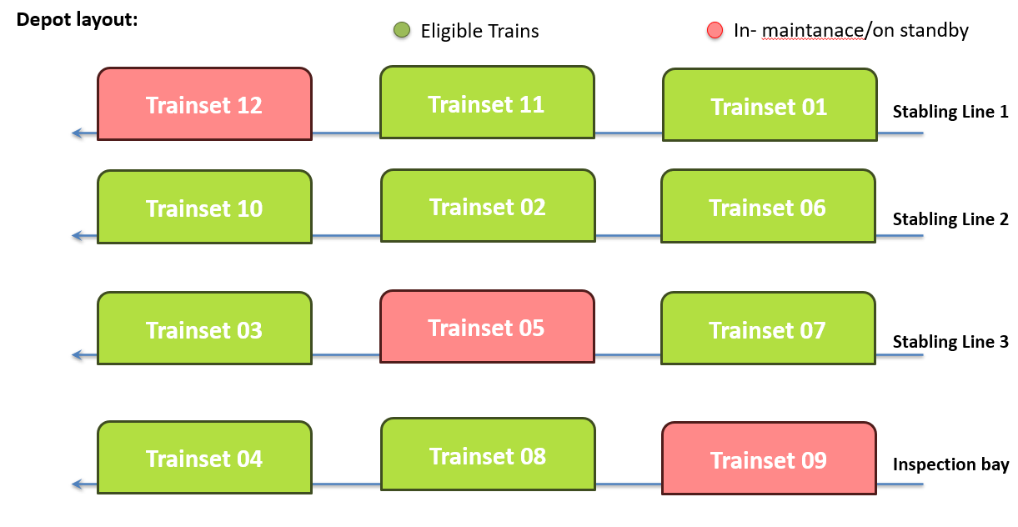
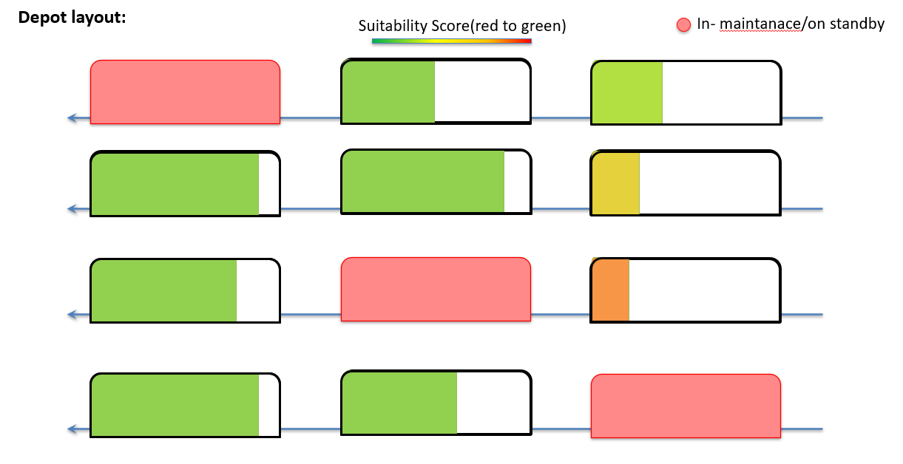
IDEA TITLE
Tech Mavericks
6 Factors
Proposed Solution
A single AI-powered dashboard that automates train induction decisions
Replaces manual, error-prone processes with data-driven optimization
Considers all 6 key factors: fitness, job-cards, branding, mileage, cleaning, stabling
Provides ranked induction list with explainable reasons (Suitability Score)
Innovation & Uniqueness
Holistic approach – balances operational safety, cost, branding, and reliability
Scalable system – works for today’s 25 trains, expandable to 40+ trains and 2 depots
Explainable AI – shows exactly why a train is included/excluded
Interactive Simulator – “What-If” feature to test scenarios instantly
Branding Priorities
Fitness Certificate
Job Cards
Cleaning & Detailing
Mileage Balancing
Depot bay positions
2

Slide 3
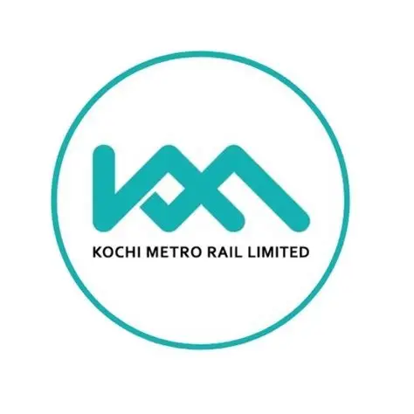





TECHNICAL APPROACH
Tech Mavericks
Data ingestion layer
KMRL
Asset Management System(AMS)
Siloed Spreadsheets
1. Data Ingestion: A Python script auto-fetch and unifies data from various files (CSVs, spreadsheets) into a clean, consistent format.
2. Data Storage: PostgreSQL database
3. Backend API: A Spring Boot server queries the database and runs the optimization logic. REST API for the frontend.
4. AI Optimization Engine: this engine first uses a Hard Constraint Filter to remove ineligible trains, then uses a Weighted Sum Model (WSM)to score and rank the remaining candidates based on business priorities.
5. Frontend Dashboard: A React.js single-page application calls the backend API and displays the final ranked list with explanations on dashboard.
Branding Priorities
Fitness Certificate
Job Cards
Cleaning & Detailing
Mileage Balancing
Stabling Geometry
AI Optimization Engine
Hard Constraints
Filter Eligible Trains
Soft Constraint Scoring Model
Fitness Certificate (0/1)
Mileage: weight = 0.3
Job Cards (0/1)
WSM
Suitability Score
Cleaning & Detailing (0/1)
Branding Priorities : weight = 0.5
Shunting : weight = 0.2
PostgreSQL database
AI Optimization Engine
PostgreSQL database
Dashboard

Slide 4
FEASIBILITY AND VIABILITY
Tech Mavericks
Feasibility
Uses existing KMRL systems (Maximo, logs, cleaning rosters)
Cloud/on-premise deployment → no new hardware required initially
Incremental adoption: start manual + Maximo → later add IoT
Challenges
Data Integration – multiple formats (Excel, WhatsApp, PDFs)
Data Quality – updates may be delayed/inconsistent
Adoption Resistance – staff may hesitate to trust AI
Real-Time Need – induction planning window is short (21:00–23:00)
Strategies
Build ETL pipelines (auto-clean data nightly)
Allow manual overrides in dashboard for flexibility
Make AI explainable so staff can trust decisions

Slide 5
IMPACT AND BENEFITS
Tech Mavericks
Impact
Supports 99.5% punctuality KPI by avoiding last-minute train withdrawals
Balances mileage to extend asset life and reduce maintenance costs
Ensures branding compliance, protecting ad revenue
Reduces depot shunting, lowering energy use and improving safety
Benefits
Economic: Lower lifecycle costs, SLA compliance, and revenue protection
Operational: Reliable train induction and reduced staff workload
Environmental: Energy savings from optimized depot operations
Passenger: Cleaner, safer, and more reliable trains for a better travel experience

Slide 6
RESEARCH AND REFERENCES
Tech Mavericks
Railway Operations: Research Railway Fleet Management and Rolling Stock Optimization for domain knowledge.
AI Algorithm: Study Multi-Criteria Decision-Making (MCDM) and Weighted Sum Models for the core ranking logic.
Technology: Review documentation for Python (Flask, Pandas), PostgreSQL, and React.js for implementation.
Sources: Use academic databases like IEEE Xplore and Google Scholar for relevant research papers.

